Slide 1


SIR Branch 17
Building the SIR Brand with Yard Signs
December 2022
Luther Burbank Branch 17
Santa Rosa

Slide 2


Why Do We Need A Public Image
Why Yard Signs
Suggested by Area 10 Governor, Bob Nadell
Gets our brand out in the public eye
Yard Signs were used in a successful campaign to save our local golf course
Useful for both Publicity and Recruiting
Not too expensive

Slide 3
Why Do We Need A Public Image
Design
Simple with key elements of the SIR brand and style
A clear message about why the reader might be interested in SIR
Contact information focused on our website URL
Designed in Microsoft Publisher to fit a standard 18” tall x 24” wide yard sign
You can download the Publisher (.pub) template from https://sirinc.org/sir-branded-marketing-materials/
Save as a PDF, which is widely accepted by printers for artwork
When saving, select the option to Optimize for Commercial Press

Slide 4
Our Yard Sign Design

Slide 5
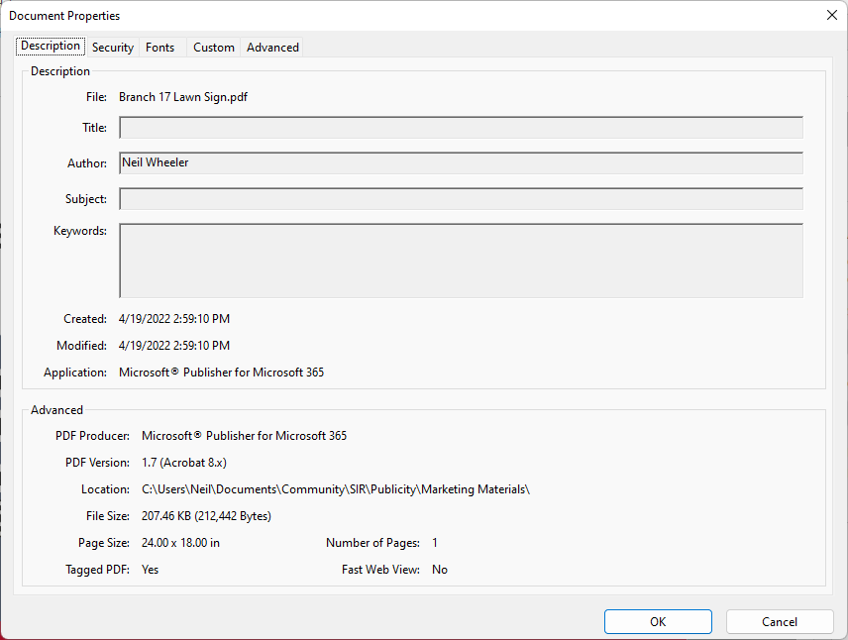
Our Yard Sign Design

Slide 6
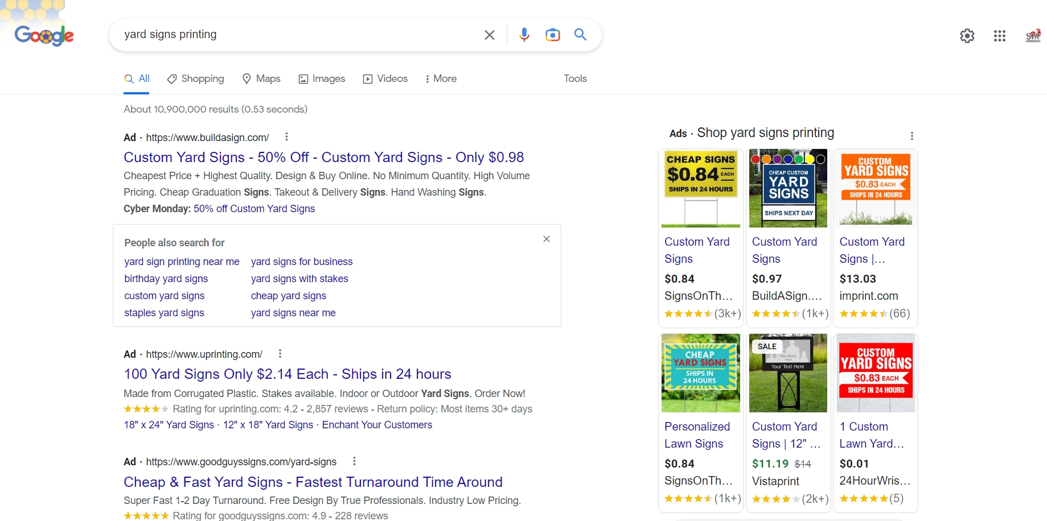
Getting the Yard Sign Printed
Four Color or Full Color
Double sided also available
Wire stands

Slide 7
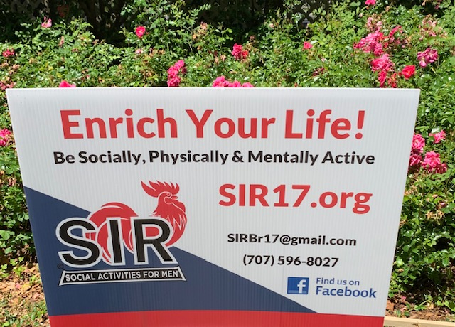
Our Yard Sign

Slide 8
Why Do We Need A Public Image
Sign Placement
Look for areas not cluttered with other signs
High Traffic Areas but with Slower Speeds
  Medians near School Crossings
  Near Stop Signs
Shopping Centers (ask for permission)
Near Golf Courses and Parks
Avoid high foot traffic areas away from shopping centers

Slide 9
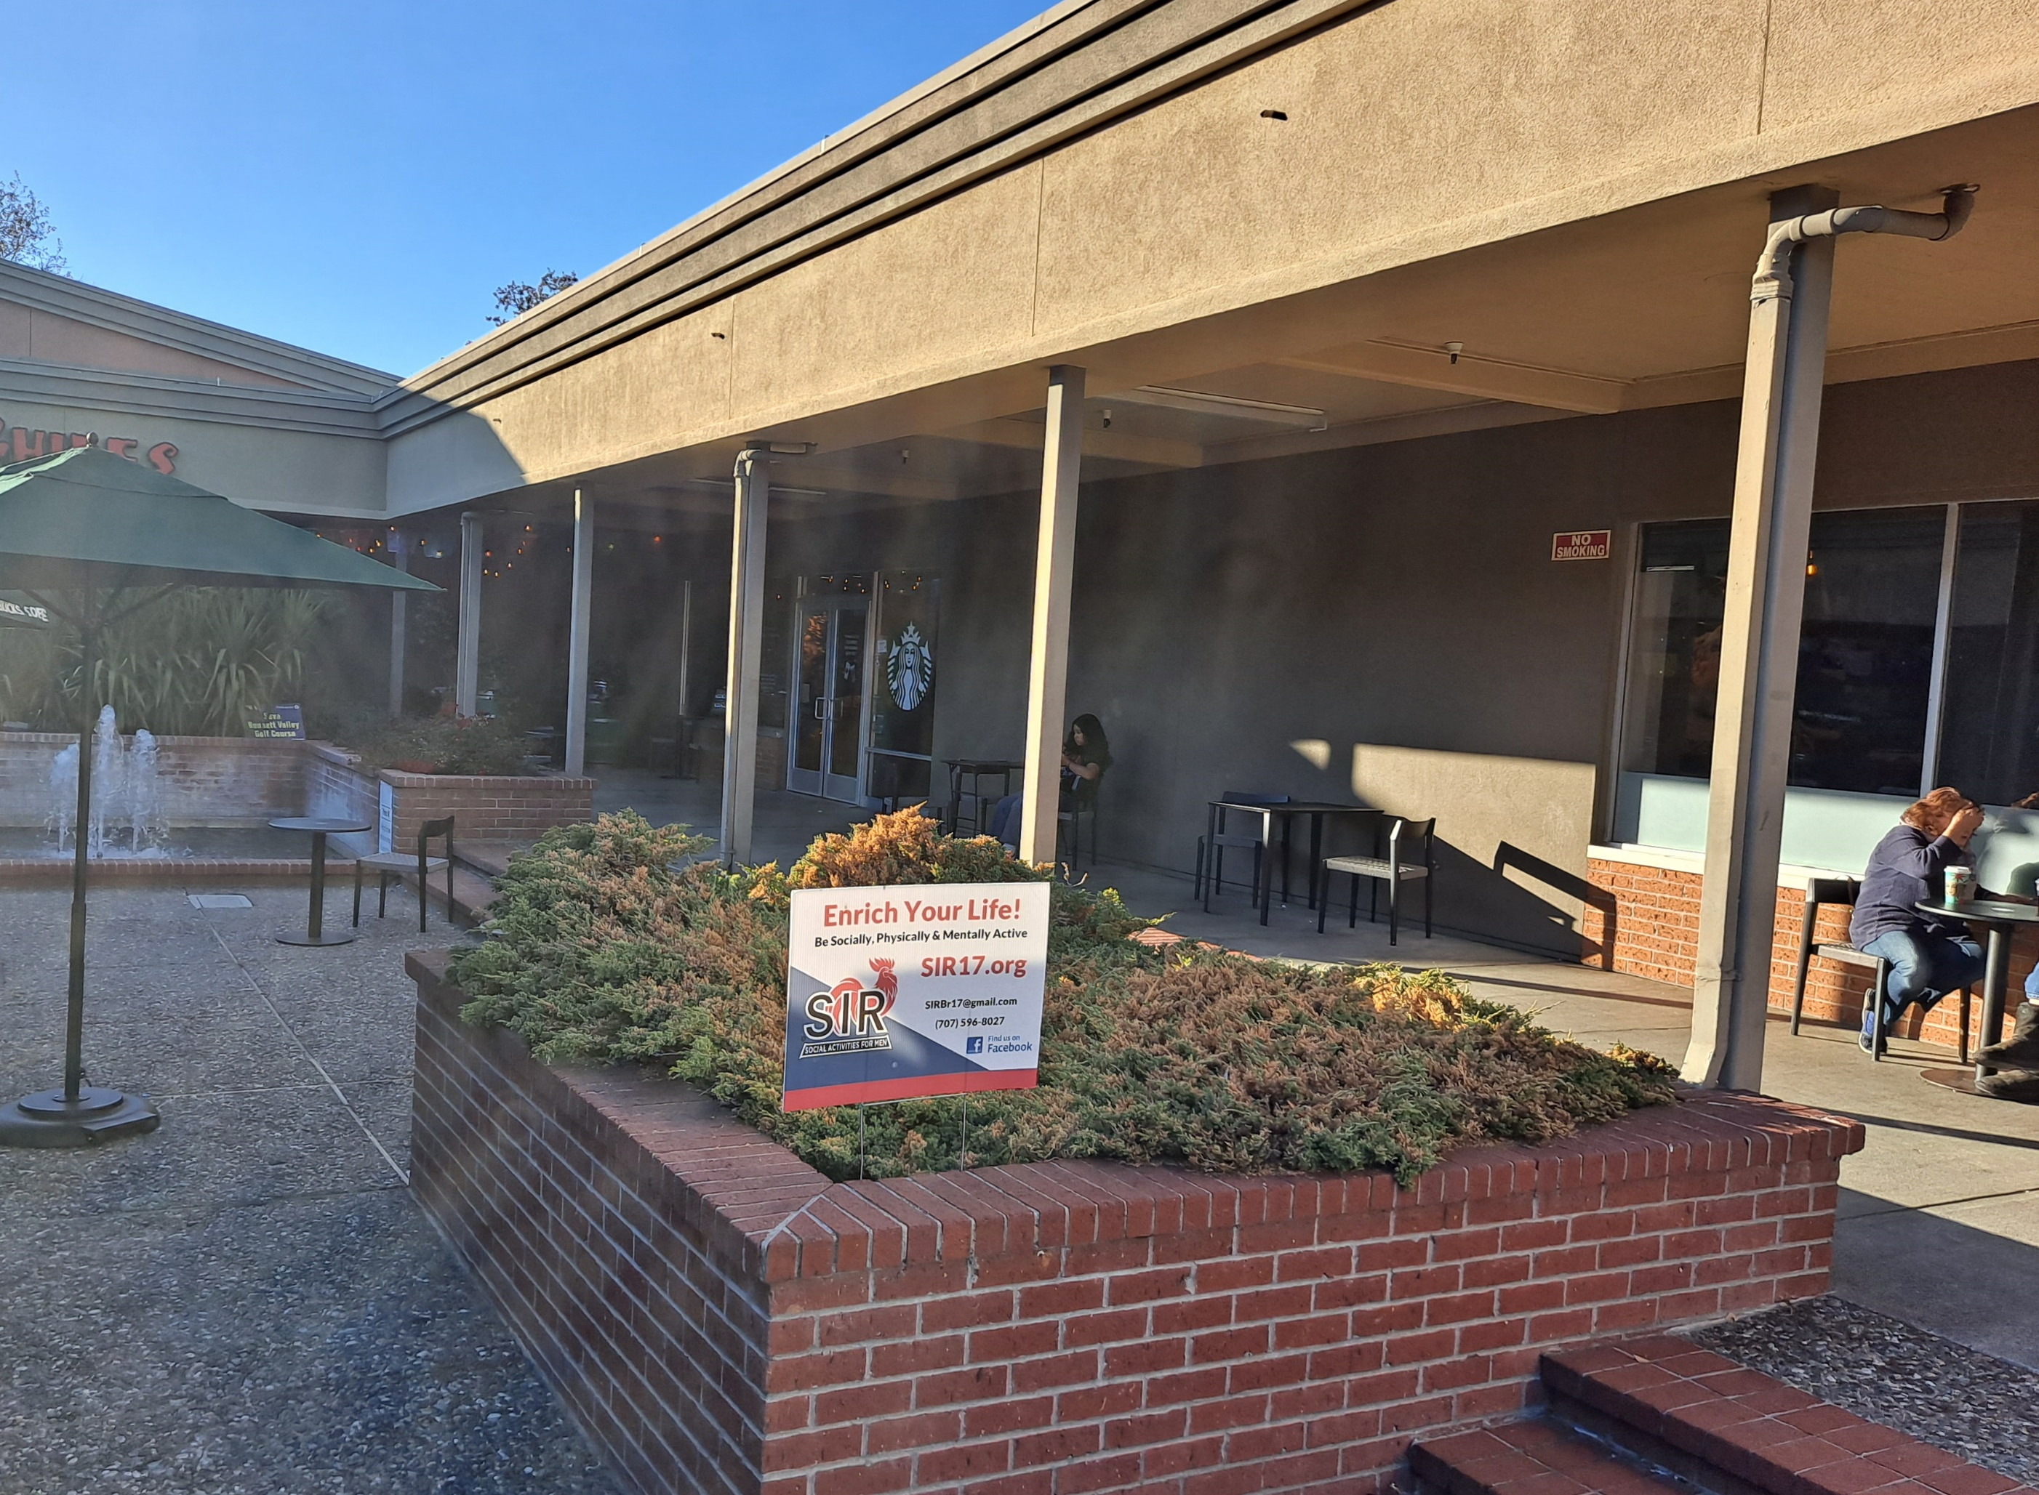
Yard Sign at Starbucks!

Slide 10
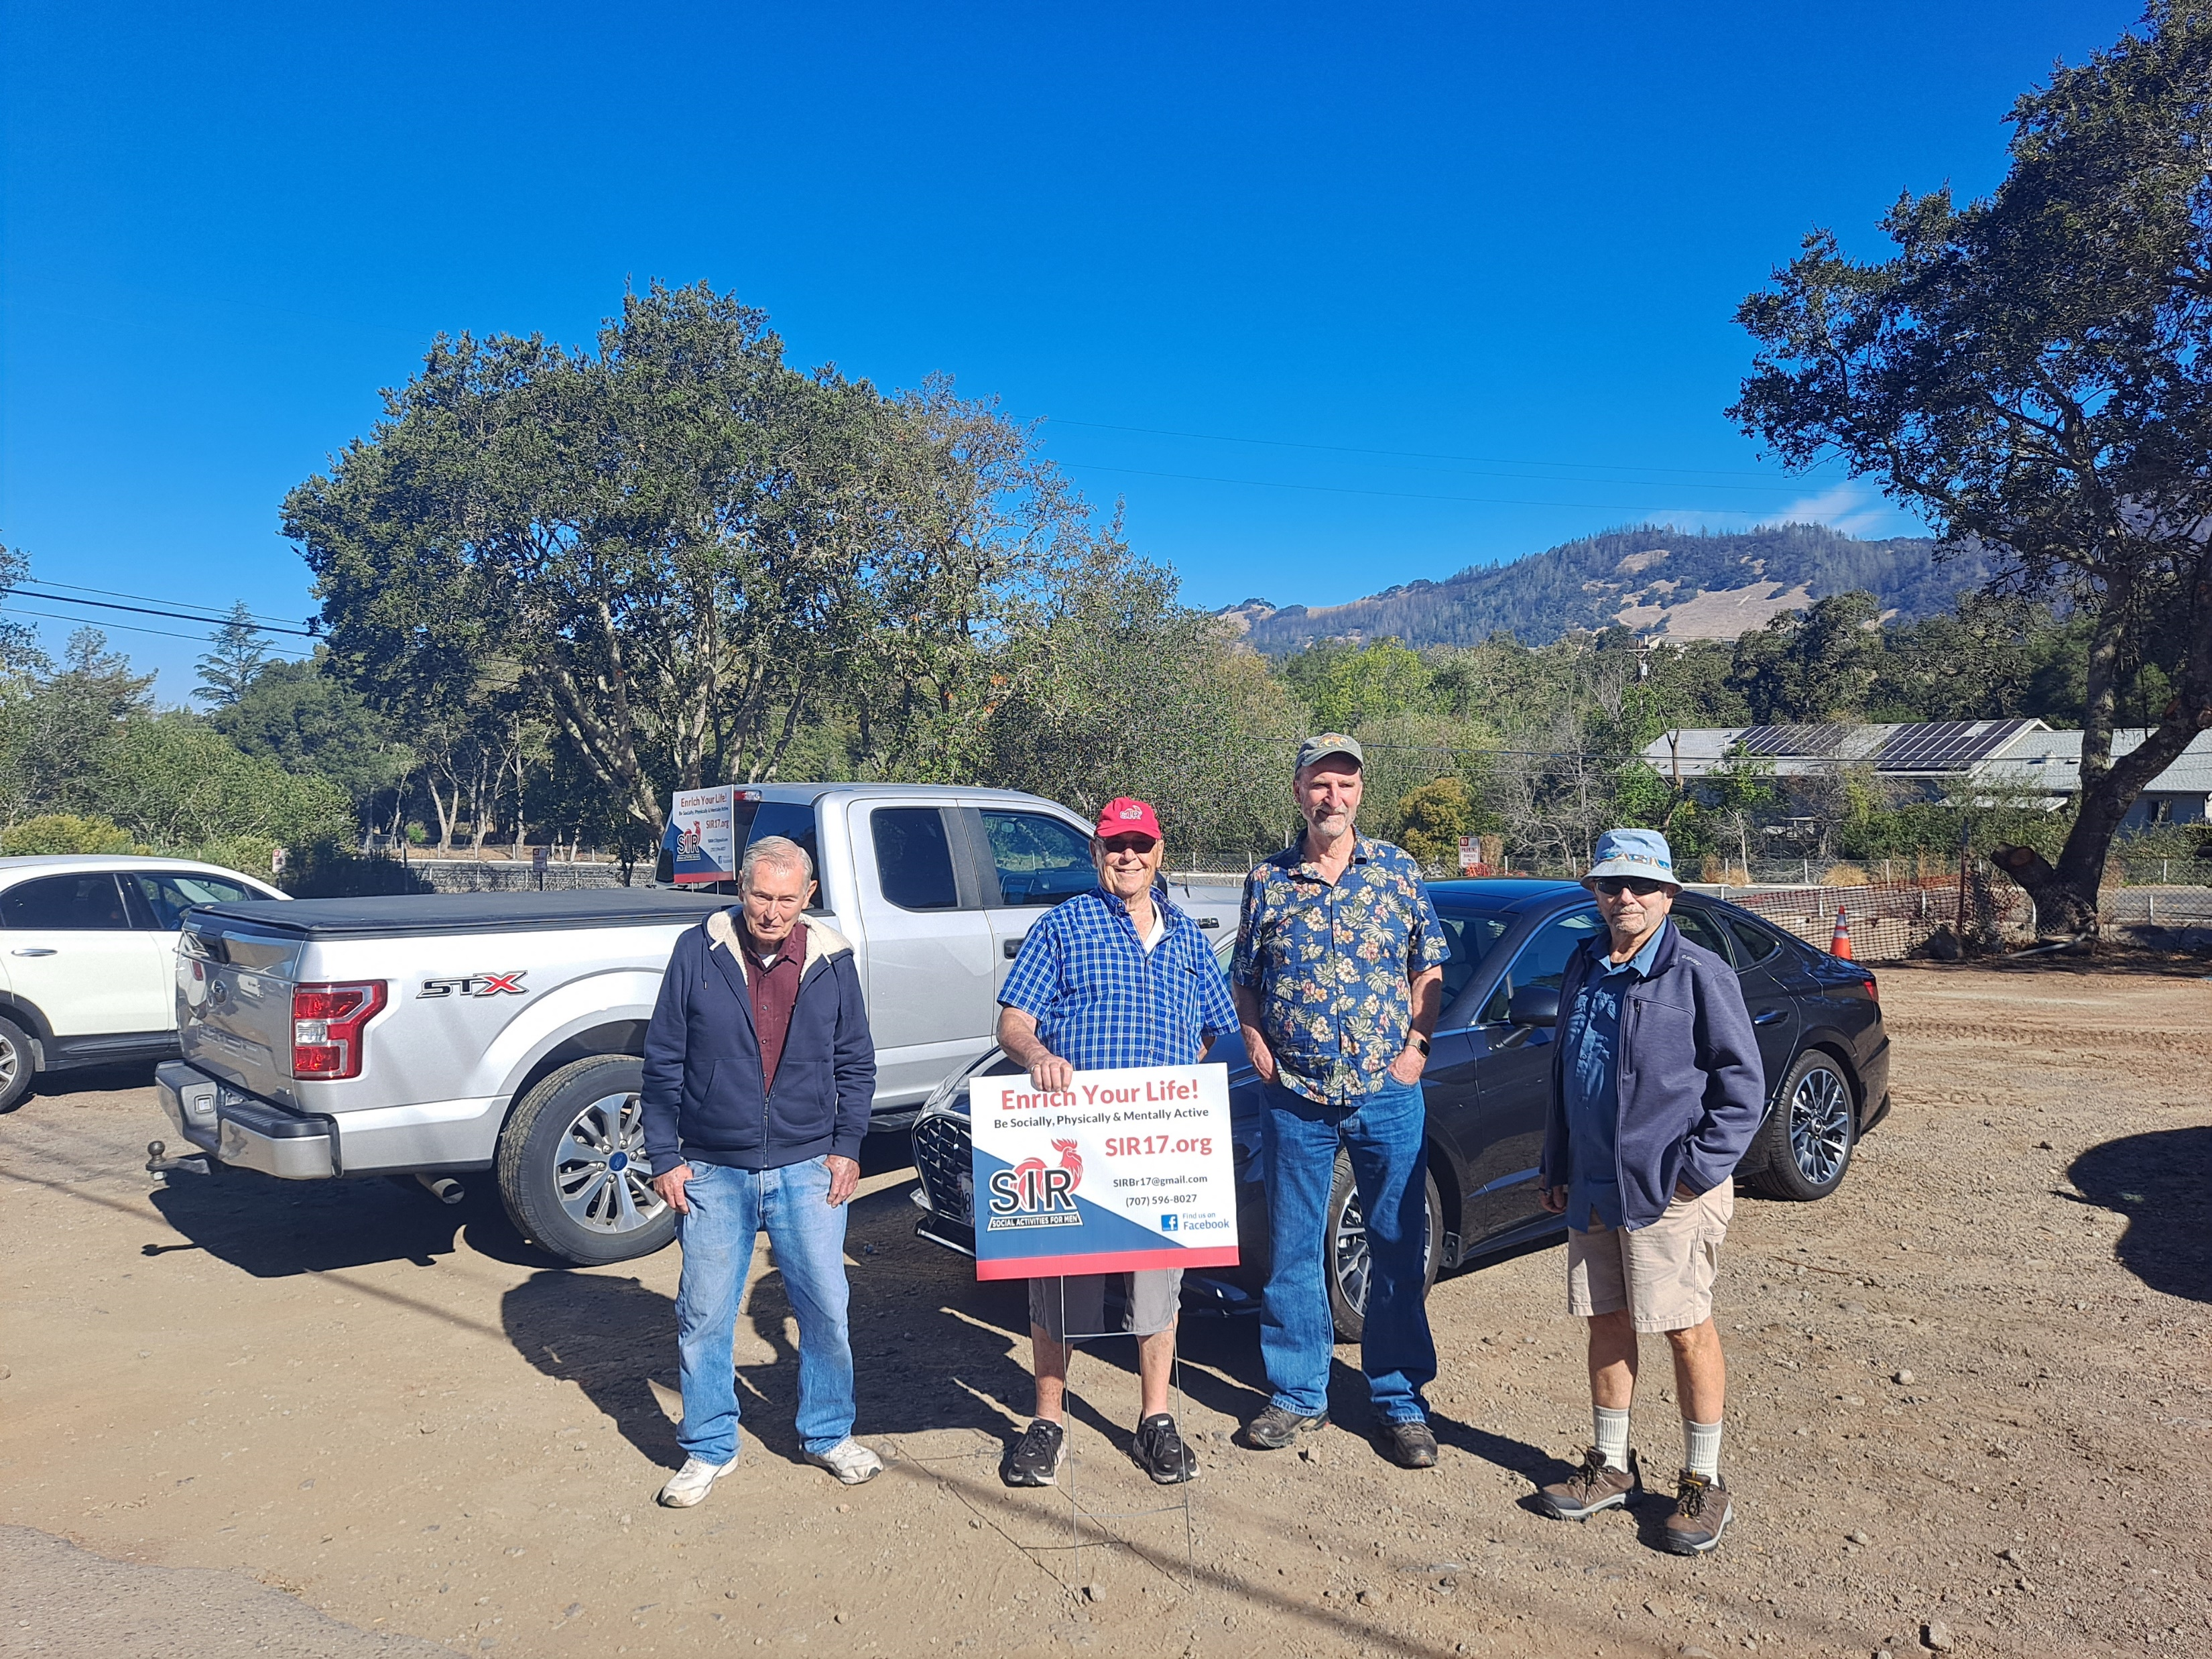
Yard Signs at Activities (Walking)

Slide 11
Why Do We Need A Public Image
Questions?
Neil Wheeler
njmwheeler@science-one.org
(707) 291-0271

Slide 12
Using Facebook

